Slide 1
The Road to Revolution
The American Pageant
Chapter 7

Slide 2
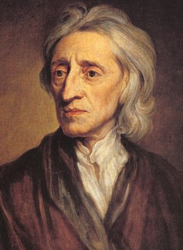
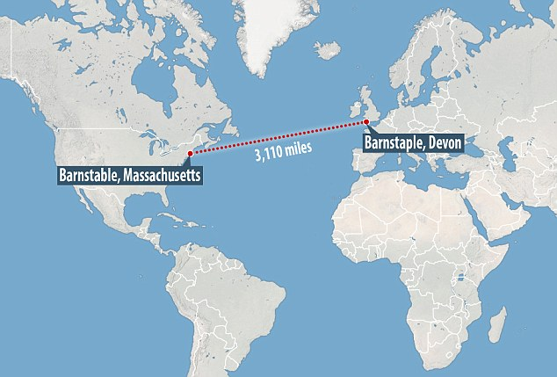
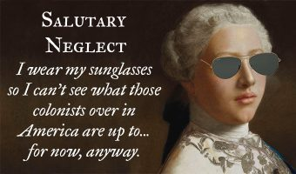
Reluctant Revolutionaries
“The Rights of Englishmen”
British roots
Time / Distance matters!
Republicanism, Radical Whigs, and the Enlightenment
The end of salutary neglect; mercantilism
Views of colonies by English
Limits on money; laws, etc.

Slide 3
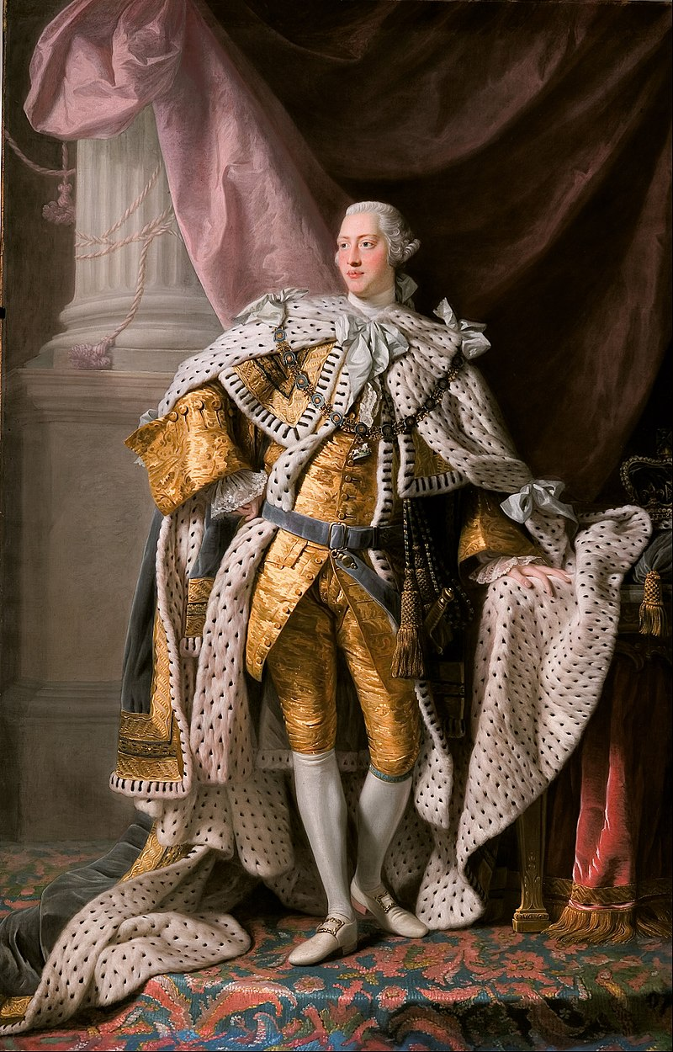
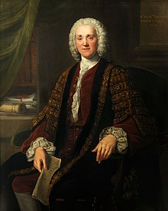
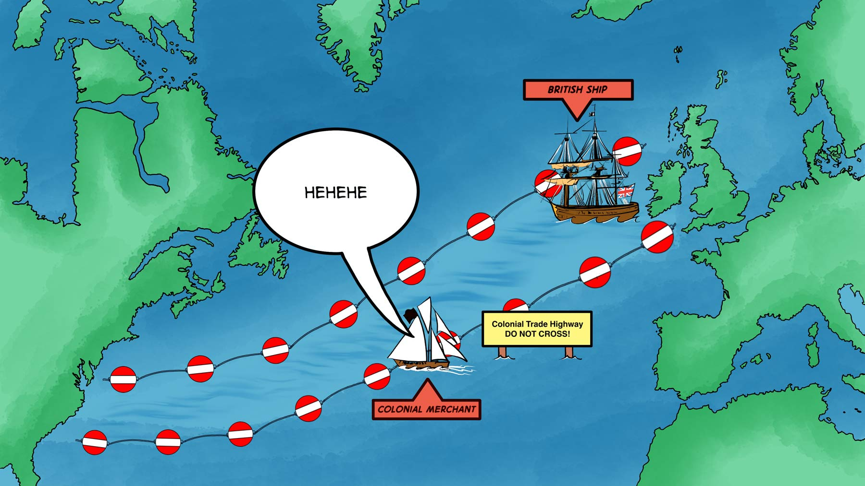
Acting Up
“No taxation without representation”
The two George’s you need to know
King George III—late twenties-early thirties
Prime Minister George Grenville
England’s victory and debt
£140,000,000
Over 28 billion dollars in modern-day value
Reinforcement of the Navigation Acts (1763)

Slide 4
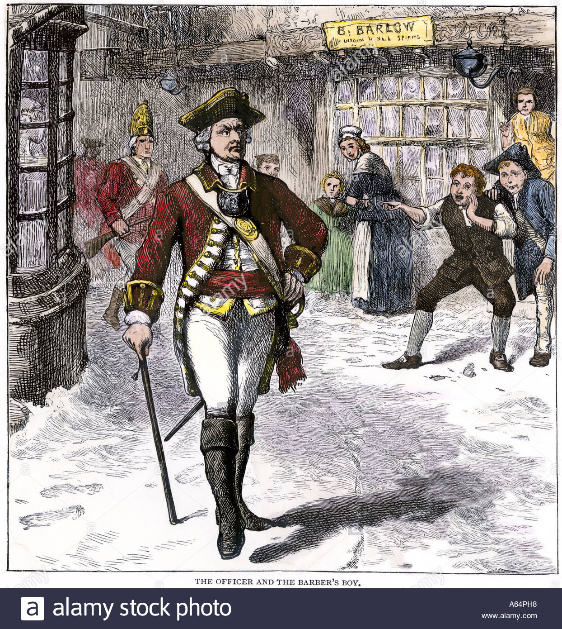
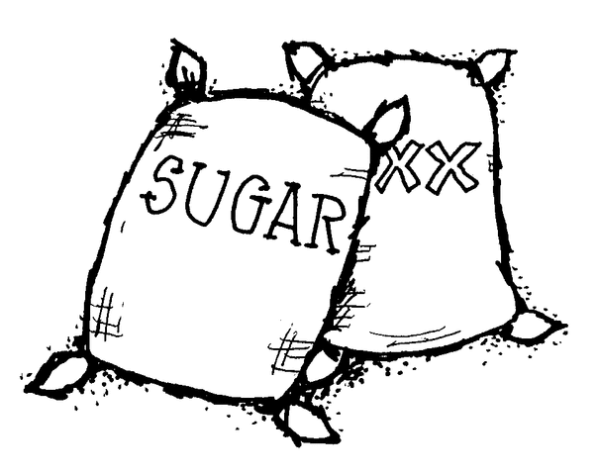
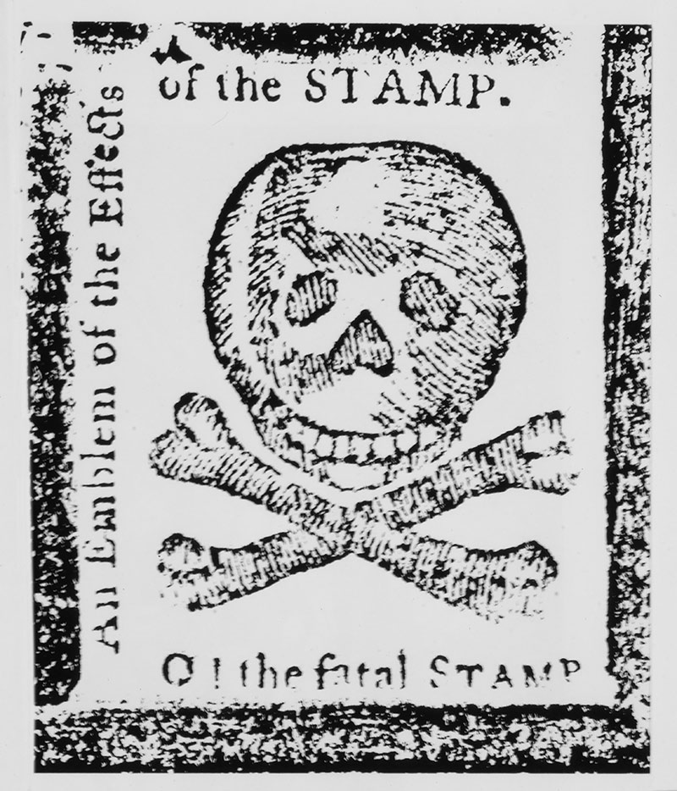
Acting Up
Sugar Act (1764)
Passed by Parliament
First tax on colonies to support the Crown
Raised duty on foreign sugar
Lowered substantially after protests
Quartering Act (1765)
Colonies provide food and housing for British soldiers
Peacetime and wartime
Stamp Act (1765)
Use of stamped paper on commercial and legal documents
Playing cards, pamphlets, newspapers, diplomas, marriage licenses, etc.
Heavier taxes payed in Britain—colonies need to pay their fair share!
Colonial Response to the Stamp Act

Slide 5
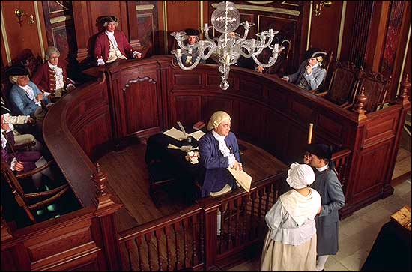
Colonial Response
Colonial Response—outrage and defiance
Admiralty Courts
Offenders / violators put on trial without a jury
Guilty until proven innocent
Legislation vs. Taxation
Representation vs. Virtual representation
Stamp Act Congress (1765)
Twenty-seven delegates from nine colonies
Debated, discussed rights;
Petitioned a repeal of the Stamp Act
Ignored in England
United the colonists even more!

Slide 6
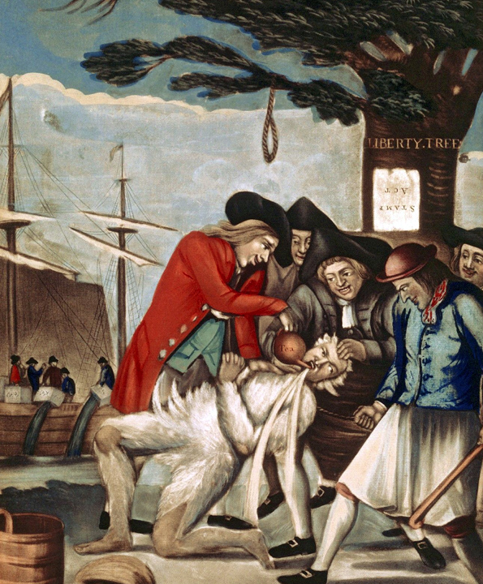
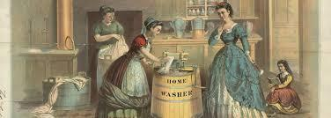
Colonial Response
Nonimportation Agreements
Refusal to import British goods
Homemade clothes; refusal to eat lambchops, etc.
United colonies further—everyone can participate
Sons, Daughters of Liberty
“Liberty, Property and No Stamps!”
Sometimes violent
Join the protest or else…
Ransacked British officials’ houses
Rule of the mob
Law was defied / repealed (1766)
NY—statue of King George erected

Slide 7
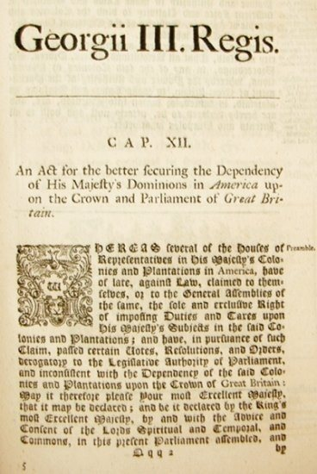
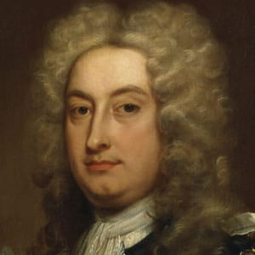
Acting Up
Declaratory Act (1766)
Parliament “binds” the colonies “in all cases whatsoever”
Essentially saying, “We own you.”
Townshend Acts (1767)
Charles Townshend
Tax on glass, lead, paper, paint, tea
To be paid at ports (by merchants)
Indirect tax
…without representation
Taxes go to support salaries of royal judges and governors in America
Revival of nonimportation agreements—not successful this time
Continued smuggling
Eventually repealed—for the most part—except tea

Slide 8
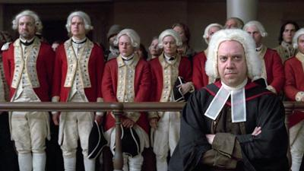
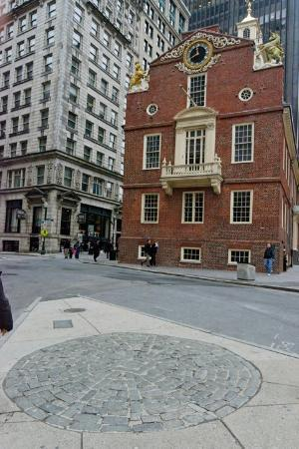
The “Spark”
British send two regiments of troops to Boston, 1768
4,000 soldiers
Colonists protest
11-year-old shot a week earlier
Snowballs, rocks, and lobster tails
Bloody Massacre, March 5, 1770
Five killed; six wounded
Crispus Attucks
John Adams (future president)
Defends British soldiers in court
Two found guilty; branded and released

Slide 9
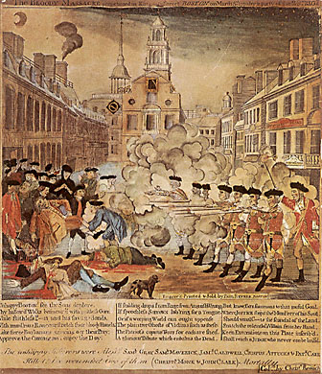
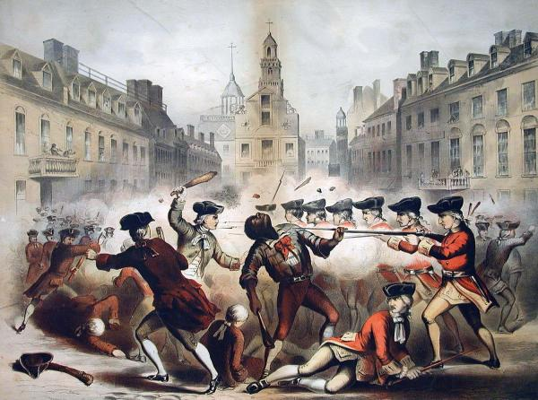
Two Portrayals of the Boston Massacre

Slide 10
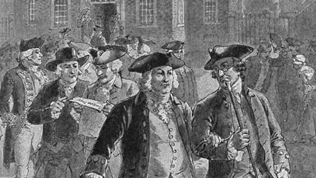
Colonial Response
Committees of Correspondence
Organized by Samuel Adams
Formed in Boston in 1772
Eighty towns across the colony follow suit
Resistance!
Next step—intercolonial committees of correspondence
Virginia

Slide 11
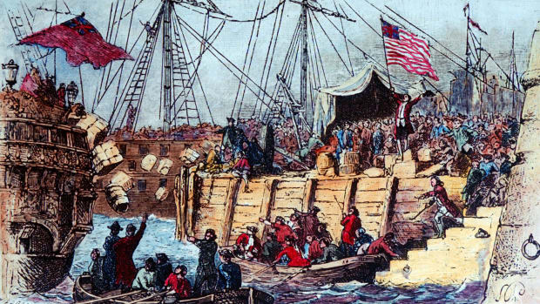
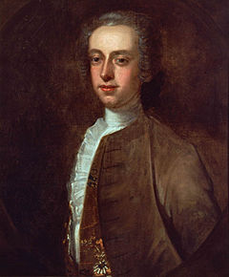
Boston Tea Party, 1773
British East India Company
Facing bankruptcy – overproduction of tea
Granted a monopoly in American colonies
LOWERED the price of tea
Keep company afloat; money goes to Britain
Protests
Turn shiploads of tea away
Burn vessels and cargo
Refusal to accept delivery of tea into colonies
Thomas Hutchinson
Governor of MA
Believed act to be unjust, enforced anyway

Slide 12
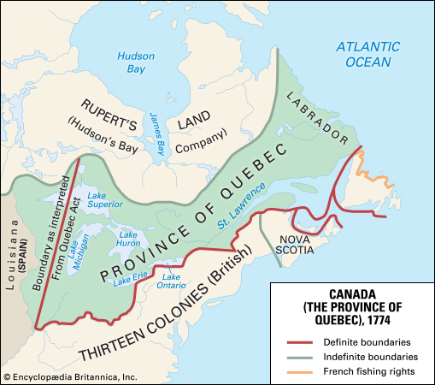
England Strikes Back
Coercive (Intolerable) Acts, 1774
Boston Port Act closed Boston Harbor until damages from the “party” were paid
Sympathy; half-mast flags; rice from South Carolina
Limitations on town meetings
British soldiers who killed colonists could be sent to England for trial
Expansion of the Quartering Act
Quebec Act, 1774
Guaranteed Catholic religion to conquered French in Canada
Preserved their institutions and customs
Quebec’s boundaries extended south to Ohio River

Slide 13
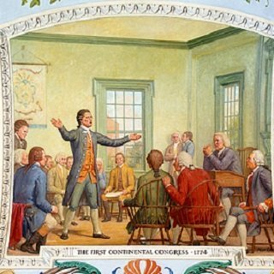
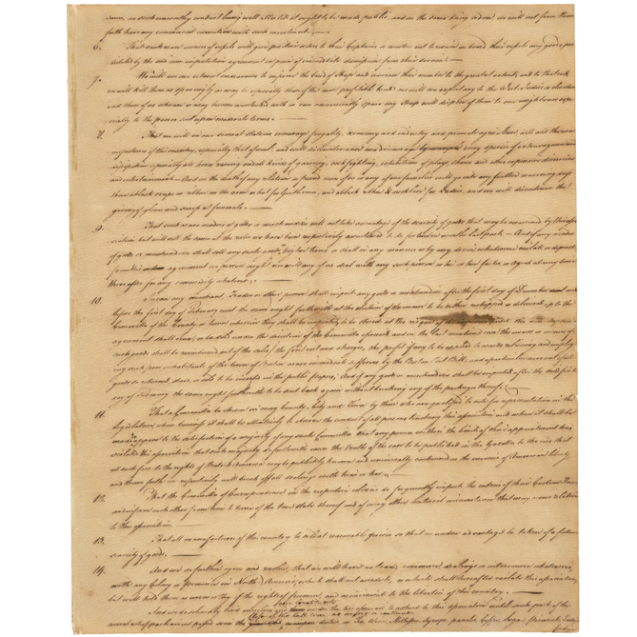
Colonial Response
First Continental Congress, 1774
Philadelphia
12/13 colonies present
55 men present—Adams, Washington, Patrick Henry
“Redress grievances”
Declaration of Rights
The Association
Calls for a complete boycott of goods
Non-export, -import, -consumption
No calls for independence…yet.
Reconvene in May 1775 if not addressed

Slide 14
Shot Heard ‘Round the world
Lexington, 1775
British sent to seize gunpowder
British sent to arrest Sam Adams and John Hancock
Paul Revere’s Midnight Ride
Minute Men
Did not disperse quickly enough
Shot at; eight killed
British move on to Concord; forced to retreat
Find safety in Boston
300 casualties; 70 deaths
This is how revolutions begin

Slide 15
England's Strengths and Weaknesses
Strengths
Weaknesses
Numbers!
7.5 million Britons to 2.5 million colonists
Money!
Army size!
50,000 soldiers for Britain, plus foreign assistance
30,000 Hessians
Militia for the colonies
The Irish problem
The lack to want to fight
Poor treatment of soldiers in America BY England
Second-rate soldiers, at that
Distance (matters!)
No real urban center to target

Slide 16
Colonial Strengths and Weaknesses
Strengths
Weaknesses
Leadership—
Washington
Franklin
Foreign aid
France
Marquis de Lafayette
Defensive fighting
Self-sustaining (agriculture)
A reason to fight
History repeats itself…underdogs win!
Little to no organization
Lacking unity
“Independent” with no legal document
Jealousy / military positions
Lack of money / depreciated value of money
Profit over patriotism
Only a minority wish to fight!

Slide 17
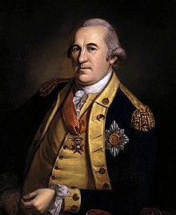
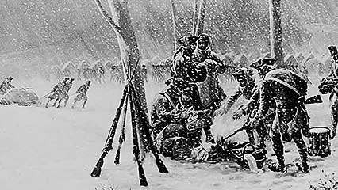
Who Is Fighting?
Colonies low on military supplies
Their supply came from Britain!
Valley Forge, PA—Winter 1777-1778
No food
No clothes
Many “soldiers” for the militia
Unreliable
Ill-trained
Sickness
Women’s role
Camp followers
Shelter; feed; clothe; fight
Baron von Steuben
German—helps train militiamen
Helps develop soldiers
African service
Initially barred from service
By war’s end—5,000 enlisted
Fight, cook, spy, build roads, etc.
Serve on both sides—freedom!

Slide 18
Timeline
Navigation Acts, 1650
Salutary Neglect
Salutary Neglect Ends, 1763
Sugar Act, 1764
Quartering Act, 1765
Stamp Act, 1765
Declaratory Act, 1765
Townshend Acts, 1767
British Occupy Boston, 1768
Boston Massacre, 1770
Boston Tea Party, 1773
Intolerable Acts, 1774
Quebec Act, 1774
First Continental Congress, 1774
Lexington and Concord, 1775
Declaration of Independence, 1776

